Slide 1
Webinar on the Shark Fin Soup Consumption Reduction Survey 2018
Drivers of demand and behavior change in Mainland China, Hong Kong, Taiwan and Singapore
July 26 2018

Slide 2
Table of Contents
HOW: Background, objectives and methodologies
WHO: Identify the key consumer groups of shark fin and mobula gill ray consumption (specific section). AND: Describe and analyse the psychosocial and socio-demographic, attitudinal and other aspects of each consumer profile and the consumer segments
WHAT: Identify the prevalence and frequency of consumption, consumption indicators and consumption behavior
WHERE: Consumption occasions
WHY: Identify the major drivers and deterrents of shark fin soup consumption
Q & A

Slide 3
1. HOW: Background, Objectives, Methodologies and Analyses
© Caters News Agency

Slide 4
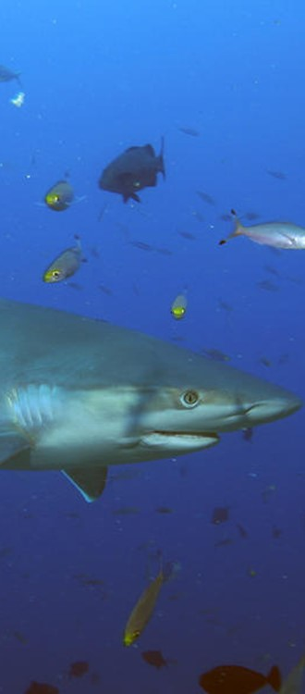
Objectives
© Brent Stirton / WWF
To provide insight into the attitudes, beliefs and values driving the consumption of, and demand of shark fin soup, manta and mobula ray gill plates (not included).
To identify specific behaviors and audiences that could form the focus of a targeted set of behavior change communications and approaches.
More specifically, the survey objectives are:
Estimate consumption in each of the four markets studied
(based on the % of respondents who claim to have consumed in the past, and does not intend to generate a figure for comparison against previous baselines set by others)
Segment the consumers (via an attitudinal segmentation), so that different segments can be best addressed in targeted messages
Uncover motivations, drivers and inhibitors of consumption of shark fin soup
Establish market comparisons: What are the differences and similarities between the market surveyed?

Slide 5
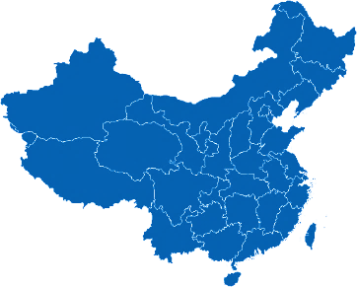
Coverage
Beijing
Shanghai
Taipei
Kaohsiung
Hong Kong
Guangzhou
Singapore

Slide 6
Research design: the three major components of this study
Literature review on earlier studies
Summary and Review of previous studies: A combination of proprietary research conducted by ADM Capital Foundation, Bloom, WildAid, TRAFFIC, WWF, GlobeScan and others.
Qualitative research
8 Focus Group Discussions with shark fin consumers in Guangzhou (2), Beijing, Shanghai, Taipei, Kaohsiung, Hong Kong and Singapore
Quantitative research
n=7099 structured online interviews in total, among which 3517 respondents are Past 12 Months Shark Fin Soup Consumers and/or mobula ray gills consumers across Mainland China (1695), Hong Kong (606), Taiwan (603) and Singapore (613)
Comparison with other surveys
Key metrics cannot be compared one-on-one with other surveys
Underlying patterns on segmentation, consumption drivers and effective messages which are relevant for the consumers, can be compared to other surveys

Slide 7
WHO: Shark fin soup consumers and segments
© AP Photo/ Kin Cheung

Slide 8
Respondents’ Profile – Gender
General Population Representative Sample vs Past 12 Months (P12M) Shark Fin Soup Consumers Sample
Mainland China
Taiwan
Hong Kong
Singapore
Legend |  | Female |  | Male
Notes:
WHY: to compare

Slide 9
Respondents’ Profile – Age
General Population Representative Sample vs Past 12 Months (P12M) Shark Fin Soup Consumers Sample
Mainland China
Avg. Age
(in years)
Taiwan
Avg. Age
(in years)
43.3
44.6
49.1
47.2
Hong Kong
Singapore
Avg. Age
(in years)
Avg. Age
(in years)
46.7
44.6
47.6
45.9
Legend |  | 18-24 |  | 25-34 |  | 35-44 |  | 45-54 |  | 55-64 |  | 65+
Notes:
WHY: to compare

Slide 10
Consumer Segmentation
The following segments of past 12 months shark fin soup consumers were identified in each of the market:
Rejecters
Either stopped consuming shark fin soup in the past year or intend to decrease consumption or stop. Their past consumption is mostly driven by social pressure.
Persuadable Consumers
Mostly occasional consumers; a majority intends to consume less shark fin soup in the future. Their past consumption is mostly driven by tradition.
Diehard Consumers
Active consumers who intend to continue consuming shark fin soup in the future. Their past consumption is mostly driven by the unique aspects of shark fin soup (i.e. taste, quality).
Segments’ Representation by Market
Mainland China
Hong Kong
Taiwan
Singapore
 | Rejecters |  | Persuadable Consumers |  | Diehard Consumers

Slide 11
Who are the Rejecters?
Consumption Behavior
Rejecters are no longer consumers of shark fin soup, i.e., they stopped consuming in the past year and do not intend to consume in the future.
Their past consumption was occasional and “passive”: They mostly consumed at wedding banquets or family reunions, mostly driven by social pressure, tradition and influenced by the elderly.
Opinion
Most concerned about the environmental consequences of shark finning, i.e., their main deterrents are related to conservation (as prompted in the survey) and cruelty, and the message on extinction strongly resonates amongst them.
Ready to support campaigns and are the most likely to repost messages on social media to do so.
Main Occasions of Consumption
Intention to
Consume Less in the Future
Wedding banquets
Business banquets/ meetings
9 out of 10
Main Drivers*
Main Deterrents*
Tradition
(in Chinese culture)
Social Pressure
(Please elders, Not to create embarrassment)
Conservation
Cruelty

Slide 12
Who are the Persuadable Consumers?
Consumption Behavior
Persuadable Consumers largest segment of consumers in all markets, except in TW.
They are mostly occasional consumers, and have consumed shark fin soup at weddings and at restaurants (or at friends reunions in mainland China).
Seven in ten intend to consume less shark fin soup in the future.
Opinion
While peer pressure and tradition are their main drivers of consumption, they also consume because they appreciate the “good” taste of shark fin soup.
The message on extinction strongly resonates (as prompted in the survey) amongst them, and they mostly trust the government to deliver messages, but are also sensitive to word of mouth (from family and friends).
Main Occasions of Consumption
Intention to
Consume Less in the Future
Wedding banquets
At a restaurant
7 out of 10
Main Drivers*
Main Deterrents*
Tradition
(in Chinese culture)
Uniqueness
(Quality, Taste)
Conservation
Cruelty

Slide 13
Who are the Diehard Consumers?
Consumption Behavior
Active consumers, and have various occasions of consumption, either social (wedding, friends reunions, etc.) or they choose purposefully to consume (order restaurants for themselves).
They think shark fin consumption may not necessarily need to be decreased, even though a majority agrees to support future shark fin campaigns.
Opinion
Main drivers are related to health benefits, are culinary (related to the exclusivity/ uniqueness of shark fin soup: “SF soup tastes good and has a special texture that cannot be replaced”) and tradition.
Their main deterrents are conservation (caveat), the legality of shark fin consumption and practical culinary barriers (hard to cook).
The message on extinction (as prompted in the survey) has less impact on them, they prefer the message on animal cruelty or luxury/status.
Main Occasions of Consumption
Intention to
Consume Less in the Future
Family Events
At a restaurant
2 out of 10
Main Drivers*
Main Deterrents*
Uniqueness
(Quality, Taste)
Conservation
Legal
(Government ban)

Slide 14
WHAT: Shark Fin Soup Consumption Indicators and Behavior
© WWF Hong Kong

Slide 15
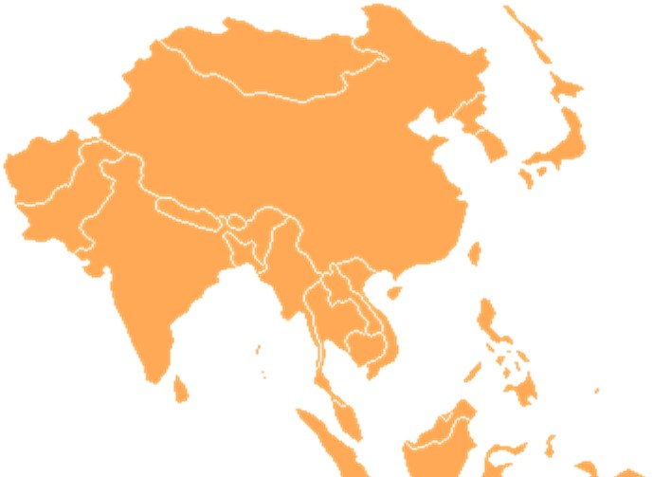
Shark Fin Soup Consumption Incidence
Shark fin soup was ‘ever’ consumed by a vast majority of consumers in Hong Kong
In Singapore, two in three claim to have ever consumed shark fin soup.
A lower incidence is observed in Taiwan and Mainland China, with respectively 58 percent and 47 percent of consumers claiming to have ever eaten shark fin soup.
 | Shark fin soup consumers in the past 12 months
 | Shark fin soup consumers (NOT in the past 12 months)
 | Never consumed shark fin soup

Slide 16
Frequency of Consumption of Shark Fin Soup [Current]
Occasional consumers (1-2 times) | Regular consumers (3+ times) | Avg. frequency (# times in past 12 months)
49% | 51% | 2.8
81% | 19% | 1.7
77% | 23% | 1.9
76% | 24% | 1.9
Frequency of Consumption of Shark Fin Soup in the Past 12 Months

Slide 17
Shark Fin Soup Past Consumption
Reasons for Deciding to Stop Consuming Shark Fin Soup (Amongst the Options Provided)
(Among those who stopped consuming in the past)
Decision to Stop or Continue Consuming Shark Fin Soup (%)
Mainland China
(n=1145)
Hong Kong,
(n=398)
Taiwan
(n=804)
Singapore
(n=570)
 | Environmental conservation/protection
 | Expensive
 | Tasteless / Do not like the taste
 | Saw shark awareness campaigns/reports
 | Cruelty of shark finning
 | Decline in population of sharks
Notes:
Did not address anti-corruption
Less on offer could also drive demand

Slide 18
Future Consumption of Shark Fin Soup
Top-2-Box: “Would definitely/ probably eat more frequently” | Bottom-2-Box: “Would definitely/ probably eat less frequently”
32% | 42%
7% | 64%
10% | 66%
12% | 46%
Future Intention to Consume Shark Fin Soup
Hong Kong and Taiwan have the highest propensity to reduce shark fin consumption, Mainland China the lowest.

Slide 19
Occasions of Consumption (top 10)
Mainland China
Hong Kong
Taiwan
Singapore
Average Number
of Occasions: 2.4 1.7 1.9 1.9

Slide 20
Decision to Include Shark Fin Soup in Meals
Deciders “All/most of the times” | Non-Deciders “Rarely/never”
31% | 31%
14% | 58%
15% | 63%
12% | 64%
Own Decision to Include Shark Fin Soup in Meals

Slide 21
Best Replacement Dish for Shark Fin Soup
Best Replacement Dish for Shark Fin Soup in Traditional Banquets (%)
Mainland China
Hong Kong
Taiwan
Singapore
Nothing can replace shark fin soup
Mainland China: 3%
Hong Kong: 3%
Taiwan: 3%
Singapore: 7%

Slide 22
WHY: Drivers and Deterrents of Shark Fin Soup Consumption
© qwerty

Slide 23
Drivers and Deterrents Analysis: MaxDiff
MaxDiff is a research methodology which allows us to understand the strength of an attribute relative to the other attributes rated.
Q9: “Now we will focus on shark fins and its consumption. On the following screens we will provide you lists of various statements. For each screen, please select the statement which describes your opinion the most, and the statement which describes your opinion the least.
Please select one statement from each box. We will repeat this question several times with different sets of statements to choose from.“
Interpretation: MaxDiff is a relative score, reported as a measure of importance
These attitudes can provide a baseline understanding of the drivers of shark fin soup consumption and the public’s perception of specific shark-related issues, and outline the parameters of which dimensions might be communicated on through the messages/ campaigns.
Comparison with Other Surveys
A MaxDiff score cannot be compared to other methodologies. For a fair comparison, it is advised to look at the ranking of the attributes and not to compare their scores.

Slide 24
Opinions on Shark Fin Soup Consumption – Mainland China
Mean Score out of 10
Most describes people’s opinion
 | Conservation/protection
 | Uniqueness
 | Social pressure
 | Symbolic value
 | Health benefits
Least describes people’s opinion

Slide 25
Main drivers and deterrents of consumption in all markets
All markets share the same Top 3 leading opinions on shark fin soup consumption (among a list of 25 statements). These opinions are all related to conservation, and are negative views of consumption, i.e. deterrents. Other deterrents relate to tradition / substitution, and consequently, challenge the social pressure associated with shark fin soup.
Leading Views (in all markets)
Other major deterrents
It is essential to protect sharks from extinction
Shark fins are harvested in a very cruel way
Shark fin soup in a set dinner can easily be substituted*
A government ban on shark fin harvesting is absolutely
necessary
The tradition of shark fin soup will soon fade out (Except
in mainland
China)

Slide 26
Main drivers and deterrents of consumption in all markets
Across all markets, the leading drivers to shark fin soup consumption are related to its symbolic value (tradition) and uniqueness (taste, quality) in all markets. Consumers also strongly agree with drivers related to social pressure (please the elders). There are also drivers by markets, i.e. health benefits in Mainland China and Taiwan.
Leading Drivers (in all markets)
Other specific drivers (by market)
Serving a shark fin dish is a tradition in the Chinese
culture
When buying shark fin, quality is the most important
In mainland China
Nurture and cure
skin conditions
Shark fin soup
tastes great
In a banquet, I don’t refuse shark fin soup, not to create embarrassment
In HK SAR and Taiwan (POC)
Shark fin soup is served to please the
elders (parents/
grand-parents)

Slide 27
Drivers and Deterrents Summary – Main Relationships (Example of Mainland China)
Cures skin
Longevity
Manliness
Health benefits
Shark protection
Cruelty
Ban
Conservation
4
3
Social Pressure to consume
Traditions
Please elders
Conformism
Taste
Quality
Texture
Uniqueness
Consumption (Before seeing visual)
Consumption (After seeing visual)
1
2
6
Legend
Positive relationship (i.e., directly influences/drives
consumption)
Negative relationship (i.e., does not directly drive consumption / potentially decreases consumption or deter from consuming)
Indicates wealth
Makes me look good
Impress business partners
Symbolic Value
5

Slide 28
Drivers and Deterrents Analysis: Path Analysis
Path analysis uncovers both direct and indirect drivers of key beliefs and behaviors that lead to the outcomes to answer the study objectives. Multiple variables were grouped into factors, or clusters of related attitudes, values and behaviors using principal components analysis.
The first cluster in the diagram relates to the social pressure consumers face when it comes to consuming shark fin soup, more specifically, to respect the tradition, respect the elders, being conformist and caring about what others think.
The second cluster refers to positive associations with shark fin soup, including its “great” taste, its quality and unique texture.
The third cluster captures attitudes towards conservation and concerns about animals and sharks specifically. These attitudes are all negative views on shark fin soup consumption, i.e., deterrents.
The fourth cluster represents the health benefits related to shark fin soup consumption, such as the belief that it cures skin conditions.
The fifth cluster represents symbolic values associated with shark fin soup consumption, such as the particular status conferred to the consumer and the indication that the consumer is wealthy.
The sixth cluster illustrates our key outcomes of intent to consume (after seeing a visual on shark finning).
1
2
3
4
5
6

Slide 29
Drivers and Deterrents Summary – Main Relationships (Example of Mainland China)
Cures skin
Longevity
Manliness
Health benefits
Shark protection
Cruelty
Ban
Conservation
4
3
Social Pressure to consume
Traditions
Please elders
Conformism
Taste
Quality
Texture
Uniqueness
Consumption (Before seeing visual)
Consumption (After seeing visual)
1
2
6
Legend
Positive relationship (i.e., directly influences/drives
consumption)
Negative relationship (i.e., does not directly drive consumption / potentially decreases consumption or deter from consuming)
Indicates wealth
Makes me look good
Impress business partners
Symbolic Value
5

Slide 30
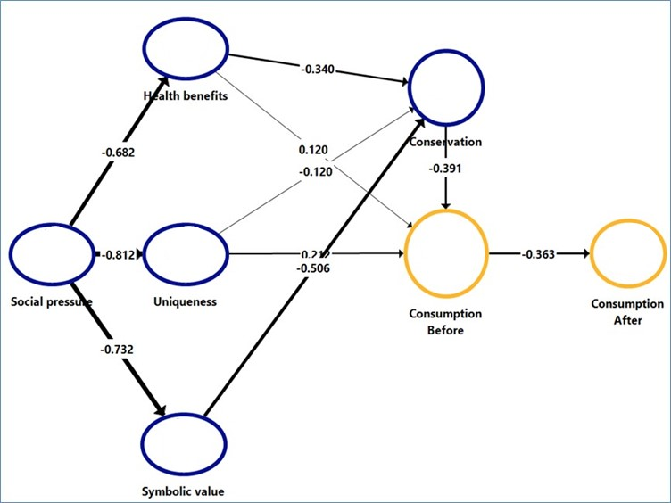
Path Analysis – Mainland China
Main Relationships and Learnings
Uniqueness and health benefits have a positive relationship to past consumption.
Symbolic value is not a major driver, i.e., the health benefits counter-balance social pressure, meaning that consumers are more likely to consume shark fin soup because they believe it will bring them health benefits (i.e., cures skin conditions) rather than being influenced by social pressure.
Moreover, for those who experience social pressure when consuming shark fin soup, the symbolic value is not high nor relevant.
The negative relation between consumption before and after exposure to the stimuli shows that consumption is mostly driven by lack of awareness of how shark fins are harvested.
4
3
1
2
6
5

Slide 31
Summing Up
The leading opinions on shark fin soup consumption are deterrents to consumption. Conservation is found to be the strongest influencer of shark fin soup (non) consumption among P12M Consumers, after respondents were shown the stimuli followed by a government ban and the awareness of animal cruelty.
These drivers suggest a sense of urgency and highlight the awareness of the consumers that shark fin soup consumption is a direct threat to sharks.
It suggests that actions need to be taken to save sharks from extinction, mostly from the government (i.e., a ban) or by the consumers themselves (i.e., use a substitute in a set dinner/banquet, stop eating).
But some ingrained drivers of consumption remain: the leading drivers are related to social pressure (i.e., tradition, please the elders, I prefer not to eat but don’t want to be embarrassed) and to the uniqueness of shark fin soup, particularly its taste and quality, and also the role of luxury/ status (with Diehard consumers). Health-related drivers (i.e., cures skin conditions) also play their part in Mainland China, though less so in the other markets.
The belief that serving shark fin soup is part of the Chinese tradition and that it is a sign of respect is a major driver of the passive consumption of shark fin soup.
Active consumption is mostly driven by the uniqueness of shark fin soup, especially taste and quality, as well as luxury/ status.

Slide 32
HOW [TO CHANGE]: Test of Concept Messages and Communication
© AFP

Slide 33
Introduction to the Section: Stimuli Offered in the Survey
The stimuli / pictures on the following slide were only shown to the respondents at the last part of the questionnaire.
So prior them answering them questions on shark fin soup consumption, on attitude, knowledge and behavior, they had not yet seen the photo’s, the stimuli and the text on the following page.
Pictures were shown at the message testing, as we wanted to test the messages as they appear in real life: in adds, in social media.
These pictures likely influenced the results, but that would (a) happen in real life and (b) the very purpose is to influence consumers.
To what extent it changes behavior is never 1 on 1 to be proofed, but our research suggests that it has a strong impact.

Slide 34
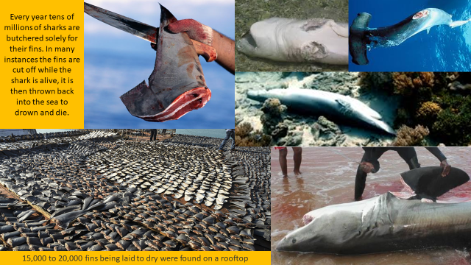
Stimuli Offered in the Survey

Slide 35
Legend: Messages
Ranking of Preferred Messages
Extinction
An estimated 100 million sharks are killed every year with fins from up to 73 million used for shark fin soup, primarily to supply the markets in Asia. And 94.9 percent of shark species cannot maintain population stability if the harvest continues. The consumption of shark fins could lead to the extinction of sharks which have lived on this planet for over 400 million years.
Animal cruelty
Expensive fin soups are made of shark fins. During fishery activities, in order to stockpile the most shark fins, sharks are often captured, finned and abandoned. Sharks without fins cannot swim in the sea and will bleed to death.
Preferred Messages (Summary of Rank 1) (%)
Health
There is no scientific evidence that shark fins can be used to treat any medical condition. On the contrary, sharks contain high level of mercury and other neurotoxins. Exposure to mercury – even small amounts – may cause serious health problems. Cooking does not eliminate mercury. In many countries, it is advised that pregnant women and children should avoid eating shark.
Mainland China
Hong Kong, SAR
Taiwan (POC)
Singapore
Illegality/extinction
Shark fin soup is widely consumed in wedding banquet as a high-end dish. Consumption of shark fin soup drives illegal fishing, which leads to dramatic drop of shark population and unsustainable species reproduction. Do not let your wedding day become the end of sharks.
Luxury/status
While including shark fin soup in a banquet seems to be a luxurious choice, it’s an old-fashioned way to show people your respect and status. Nowadays, people respect those who are conscious on the environmental impact of their consumption.
Law [for China only]
The Chinese government has banned consumption of shark fin dishes in official banquets since 2012. Even if we are not government officials, we’d like to follow this ban because it is the right thing to do.

Slide 36
Communication and Messages on Shark Protection
Preferred Message
2nd Preferred Message
Among the past 12 months consumers, the message on Extinction is most ranked as the preferred message out of the (limited list) of options provided in all markets.
% Ranked as Top 1 message:
Among the past 12 months consumers, the message on Animal Cruelty gets the 2nd best score as the preferred message out of the options provided in all markets.
% Ranked as Top 1 message:
An estimated 100 million sharks are killed every year with fins from up to 73 million used for shark fin soup, primarily to supply the markets in Asia. And 94.9 percent of shark species cannot maintain population stability if the harvest continues. The consumption of shark fins could lead to the extinction of sharks which have lived on this planet for over 400 million years.
Expensive fin soups are made of shark fins. During fishery activities, in order to stockpile the most shark fins, sharks are often captured, finned and abandoned. Sharks without fins cannot swim in the sea and will bleed to death.
Note: Messages selected from a limited range. This does not necessarily mean that people will stop consuming shark fin, after hearing the preferred message.
Hong Kong 30%
Hong Kong 21%
Taiwan 36%
Taiwan 26%
Mainland China 34%
Mainland China 17%
Singapore 33%
Singapore 21%

Slide 37
Summing Up
In Campaigns support
In Hong Kong and Singapore, 6 in 10 of the consumers intend to support a campaign versus over 8 in 10 in mainland China and Taiwan. The type of support they intend to give is similar in all markets:
Stop consuming shark fin soup
Speaking with family/ friends
(Re-)posting messages on social media

Slide 38
Summing Up
Most Trusted messengers
HK
Government
48%
Celebrities
41%
Taiwan
Celebrities
49%
Government
44%
Mainland China
Government
50%
Journalists
41%
Government
51%
Family
33%
Any Questions?
Singapore

Slide 39
Any Questions?

Slide 40
ADM Capital Foundation is an impact driven foundation focused on making change in Asia. Through research, ADM Capital Foundation identifies environmental challenges then work towards solutions across five key areas: marine ecology, water security, air quality, wildlife trade and forestry conservation finance.
WWF is one of the world's largest and most respected independent conservation organizations, with over 5 million supporters and a global network active in over 100 countries. WWF's mission is to stop the degradation of the Earth's natural environment and to build a future in which humans live in harmony with nature, by conserving the world's biological diversity, ensuring that the use of renewable natural resources is sustainable, and promoting the reduction of pollution and wasteful consumption. www.panda.org/news
TRAFFIC, the wildlife trade monitoring network, is the leading non-governmental organization working globally on trade in wild animals and plants in the context of both biodiversity conservation and sustainable development. TRAFFIC is a strategic alliance of WWF and IUCN.
www.traffic.org
GlobeScan is a strategy and insights consultancy, focused on helping our clients to build long-term trust with their stakeholders. Offering a suite of specialist research and advisory services, GlobeScan partners with clients to meet strategic objectives across reputation, sustainability and purpose. Our Purpose is to build leadership for a better world and help understand and drive Sustainable Living.
www.globescan.com

